Slide 1
Student Record Dashboard
By-
1.Bhoomika s horapeti-113710077
2.Navya m - 113710078

Slide 2
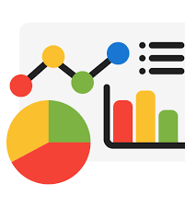
Project Overview
The Student Result Dashboard is a web-based application designed to analyse and visualize academic performance. It allows uploading student data through CSV files or manual input, then processes the data using Pandas and displays visual insights using Matplotlib. The system also integrates machine learning features for grade prediction and student clustering.

Slide 3
Objectives
Automate analysis of student academic performance
Visualize data using graphs and charts
Implement grade prediction using ML
Cluster students based on performance

Slide 4
Data Input
Users can upload a CSV file or enter data manually through a form. The CSV includes fields like ID, Name, and subject-wise marks.
ID | Name | Math | Science | English
101 | Alice | 89 | 76 | 92
102 | Bob | 58 | 64 | 60
103 | Charlie | 45 | 50 | 48

Slide 5

Data Analysis with Pandas
Processes include computing total and average marks, determining pass/fail status, finding top performers, and class-level statistics. All analysis is done using the Pandas library.

Slide 6
Visualizations with Matplotlib
Bar charts: Marks per subject per student
Pie charts: Pass/fail distribution
Line graphs: Average performance trends

Slide 7
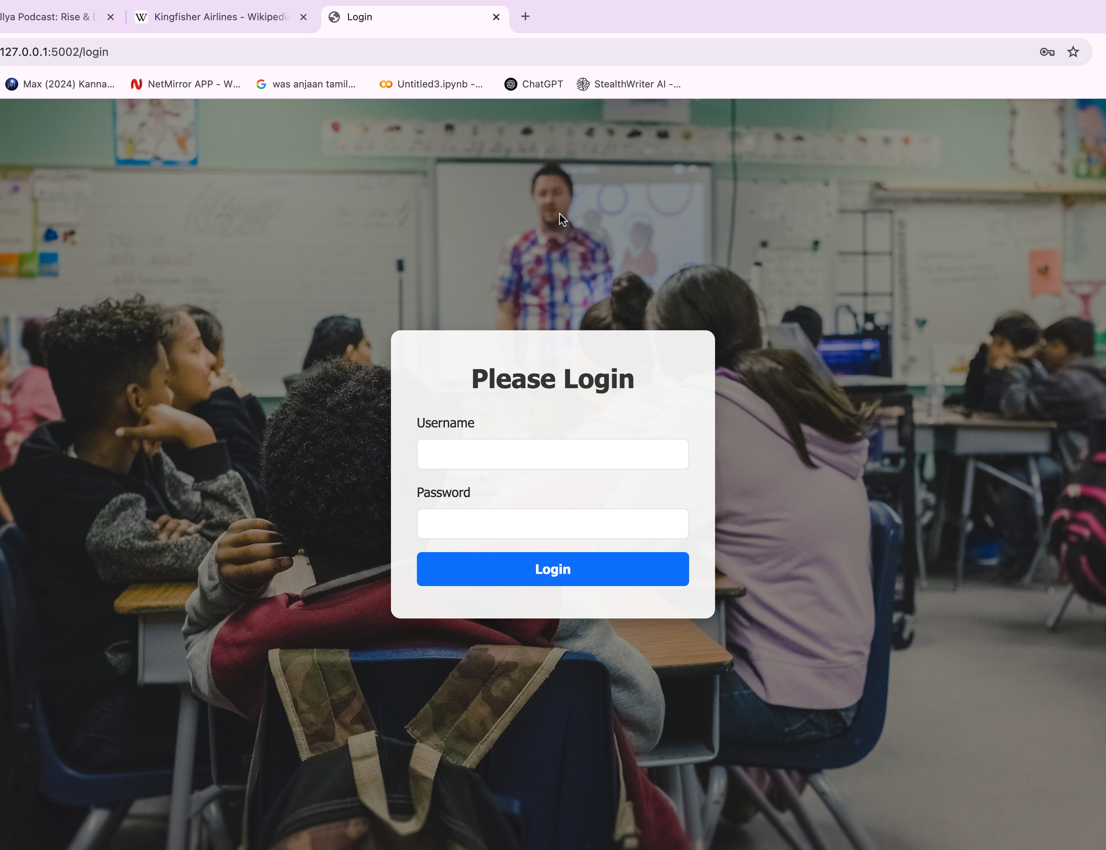
Web Interface using Flask
A user-friendly web interface allows user to login/logout to the portal. Built using Flask, it ensures clean navigation and interactivity.

Slide 8
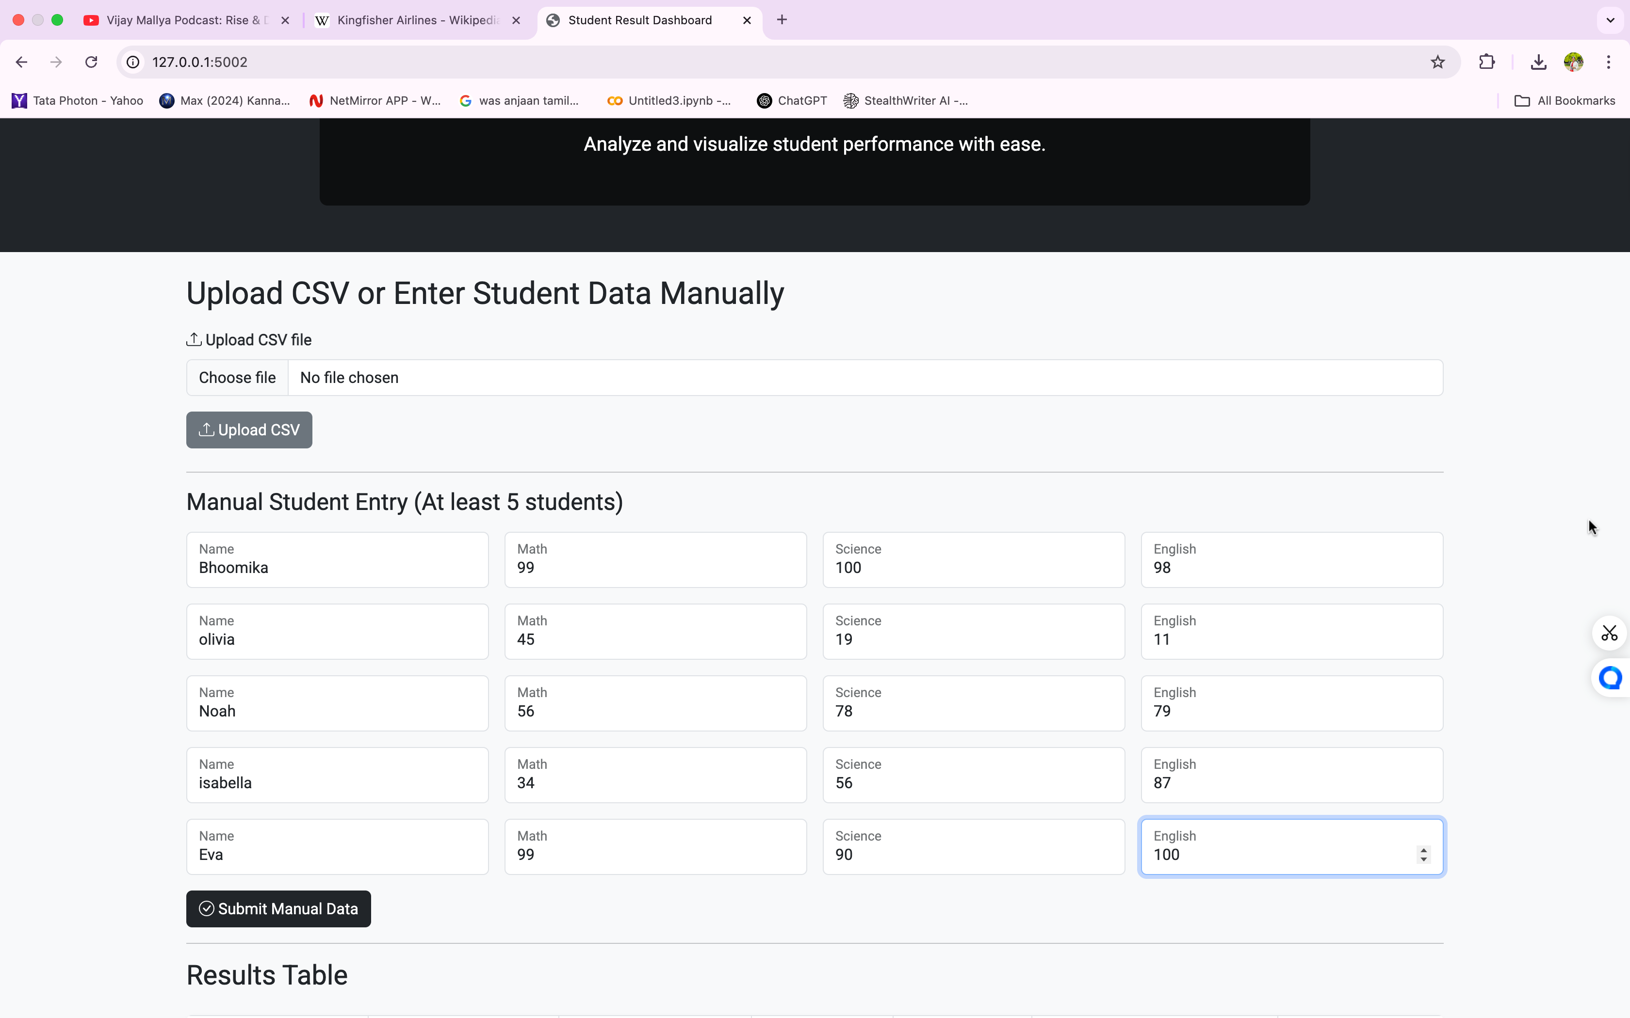
Homepage
After logging in, web interface allows you to either upload file or add the data manually through form and displays results and visualizations.

Slide 9
Machine Learning Features
Grade prediction using Decision Tree Classifier
Student clustering using KMeans to identify High, Average, and Low performers

Slide 10
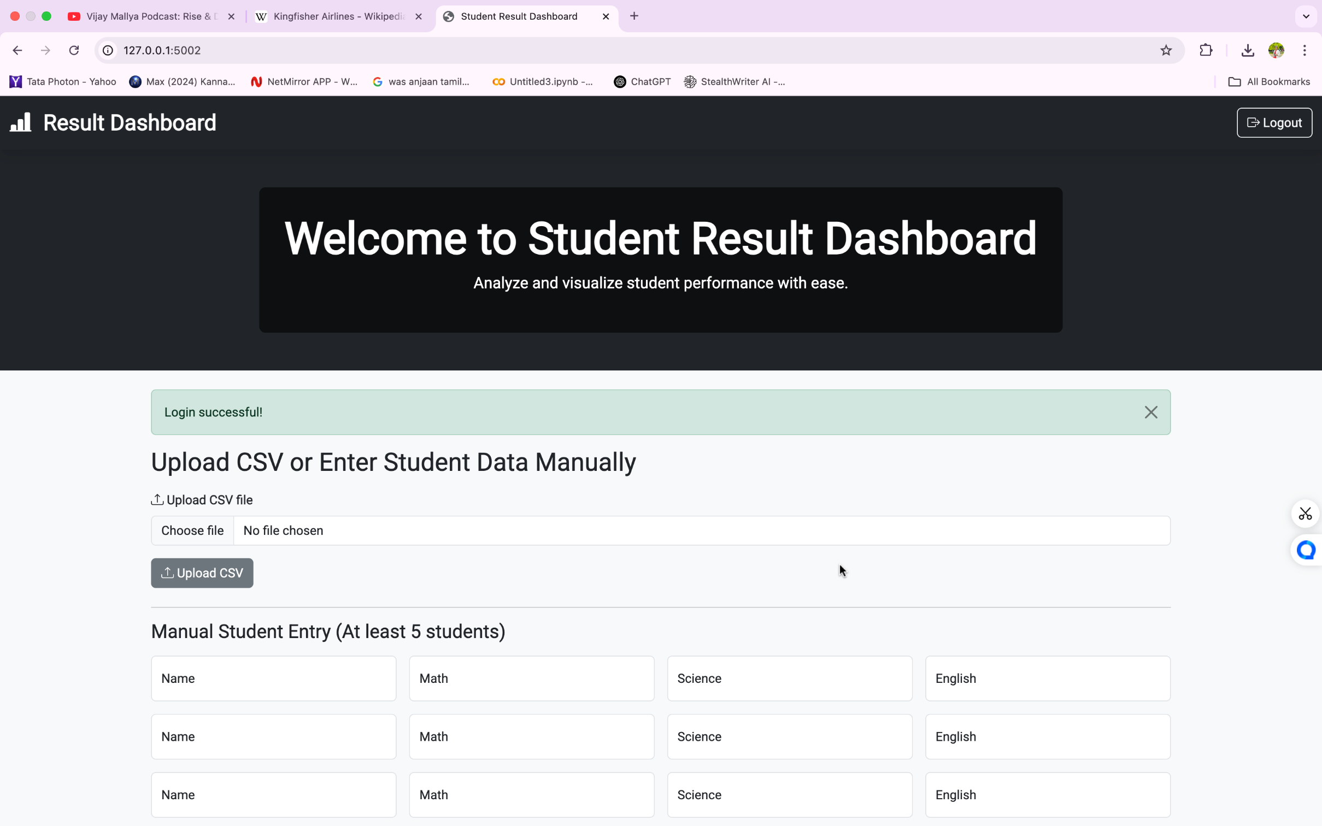
Results

Slide 11
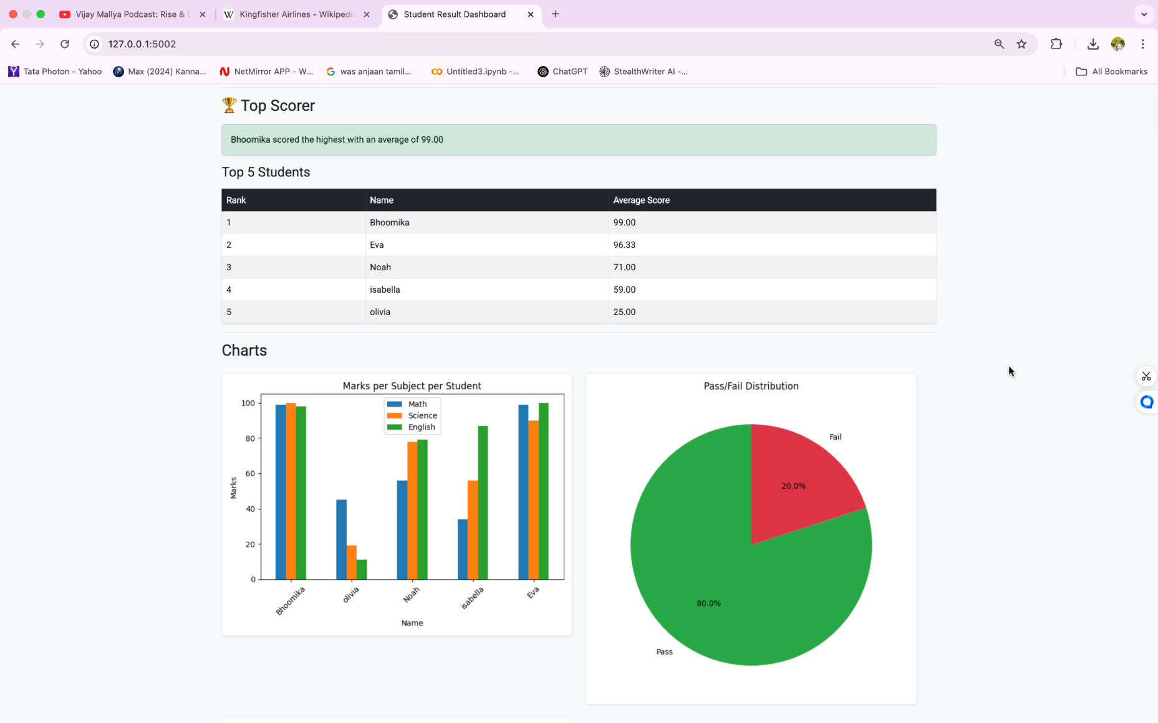
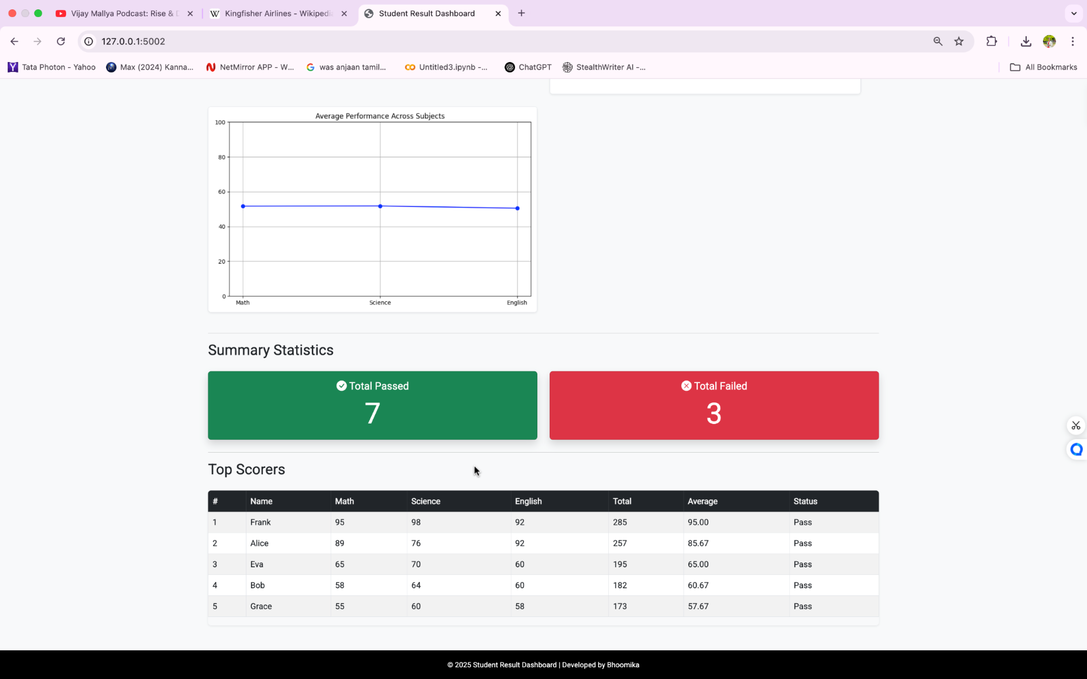
Results

Slide 12
Challenges & Learnings
Faced issues with Jinja templates, data formatting, and integrating machine learning.
Learned how to debug Flask apps, preprocess data for ML, and deploy full-stack applications.

Slide 13

Conclusion
The Student Result Dashboard successfully demonstrates the integration of data analysis, visualization, and machine learning into a user-friendly web application. By automating result processing and offering insightful performance metrics, it simplifies academic evaluation. With features like CSV/manual input, login/logout, and graphical insights, the project not only meets its core objectives but also lays a strong foundation for future enhancements such as database integration and role-based access.

Slide 14
Future Works
1.Integrate a secure database with role-based access control for administrators, teachers, and students.
2.Add features like automated performance report emails and subject-wise grade prediction.
3.Enable semester-wise analytics to enhance academic insights and system scalability.

Slide 15

Thank You !!

